Slide 1
Lowell Joint
Virtual Academy
Parent Information Meeting April 19, 2021

Slide 2
Agenda
Virtual Academy vs. In-Person Instruction
Guiding Principles for the Virtual Academy
Schedule for the day
Enrollment – Commitment - Timeline
Summer Parent Workshop
Communication
FAQs

Slide 3
This is not an independent study program
We anticipate that schools are open and local and state health officials have approval for in-person instruction
In-person Instruction
Virtual Academy
Full Program: Students return to school in a traditional manner with wellness practices firmly reinforced while a continued full-time distance-learning option will be available for families. (Aligned with State Phase 3). School opens August 18, 2021 in a traditional format with all of the Public Health precautions addressed. (7th Grade is half day on August 17, 2021).
Staff who meet the requirements or based on numbers, have offered to teach virtually
Students who meet the requirements to participate in online instruction

Slide 4
Guiding Principles for the development of the Virtual Academy
Assembly Bill 77 and Senate Bill 98

Slide 5
AB 77-Education Budget Trailer Bill
Ed Code 43503
(a) (1) For the 2020–21 school year, a local educational agency that offers distance learning shall comply with the requirements of subdivision (b).
(2) Distance learning may be offered under either of the following circumstances:
(A) On a local educational agency or schoolwide level as a result of an order or guidance from a state public health officer or a local public health officer.
(B) For pupils who are medically fragile or would be put at risk by in-person instruction, or who are self-quarantining because of exposure to COVID-19.

Slide 6
AB 77-Education Budget Trailer Bill Students who are eligible:
“The language makes allowances for medically fragile students, and those in self-quarantine, but also for those students who would be put at-risk by an in-person instructional model. The statute does not define “would be put at-risk by in-person instruction” and as such, does not require an LEA to verify or make a determination that a request for this allowance meets a specified standard. This section contemplates that LEAs may provide distance learning to students with varying circumstances – whether the student has health conditions, family members with health conditions, cohabitates or regularly interacts with high-risk individuals, or is otherwise identified as “at-risk” by the parent or guardian.”

Slide 7
Virtual Academy - Lowell Joint School District
Online Distance Education and learning will take place through Google Classroom.
Communicate
(Padlet/Teacher Connect)
Teach
Connect
Feedback/
Assessment
Post an announcement on Monday, via text or video to provide an overview of the week.
Check email multiple times daily.
Create standards-based lessons aligned with your curriculum and post the lesson on Google Classroom or other district platforms daily.
.
Provide opportunities at least two times per week for students to share their learning with their classmates and interact with you to discuss or ask questions.
Once per week, gather assessment data. This can be through a Google Form, Illuminate, Think Central, Big Ideas, Quizizz, etc OR through a creative project students put together.
Google Classroom
Follow a Traditional Classroom Schedule
Zoom OR
Google Meets
Google Sites
Flipgrid
Illuminate
E-mail
Google Classroom

Slide 8
TK-6 Learning Guide - Weekly Lesson Plan
Content to be delivered through online instruction with some video, text, and other supports. The focus is on synchronous activities.
Asynchronous time does not count as part of the State required instructional minutes.
DRAFT

Slide 9
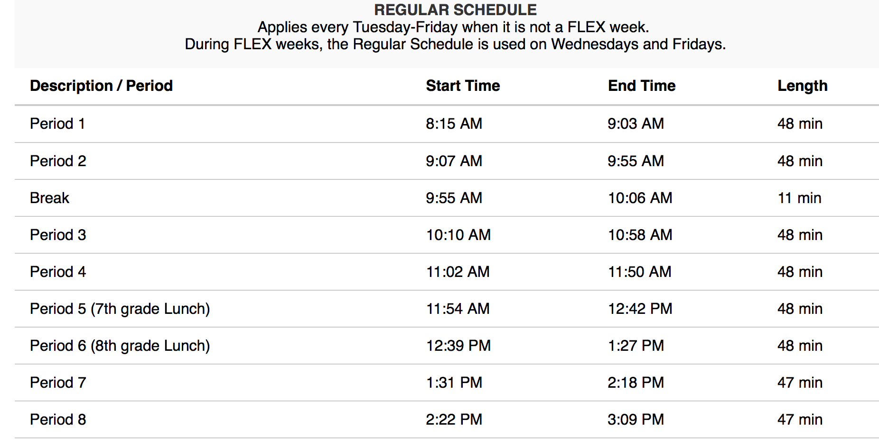
7th – 8th Learning Guide - Weekly Lesson Plan
Students will be enrolled in a rotation with single subject teachers, a daily schedule which will be created for those courses.
You will have live stream traditional periods from Rancho for core subjects and elective subjects based on enrollment.

Slide 10
EDI instructional cycle :
*Direct Instruction
*Guided Practice
*Small Groups
-Differentiating
-Collaboration
*Independent Practice
*Feedback

Slide 11
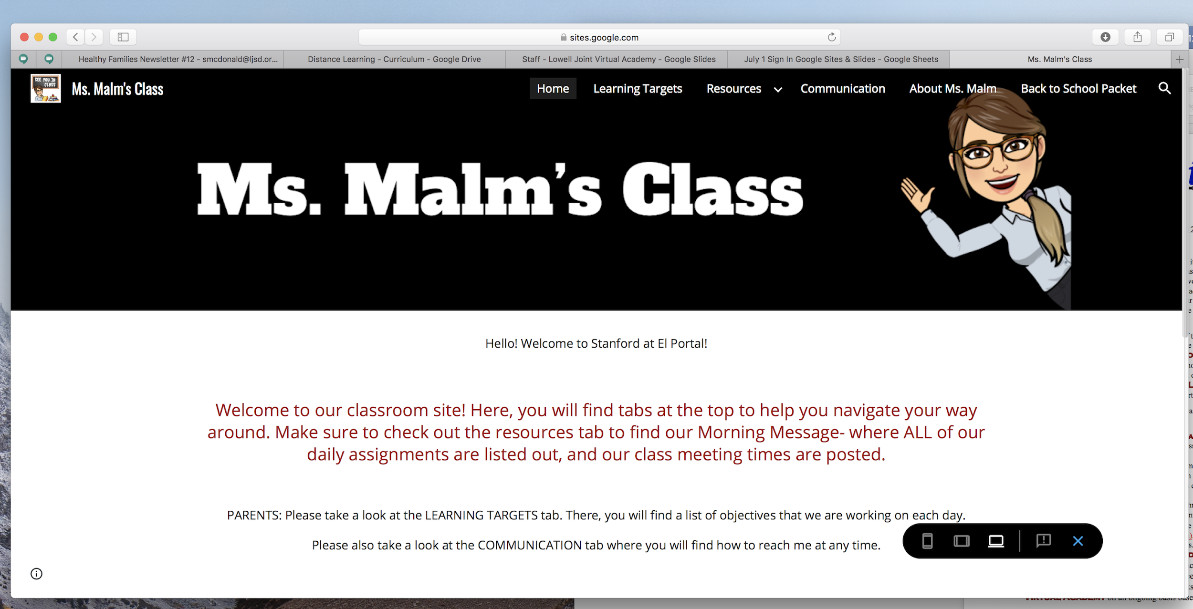
Sample website and lesson plans
Expectations- Virtual Academy teachers will have a robust website to facilitate communication and instruction with students and parents
Sample Only

Slide 12
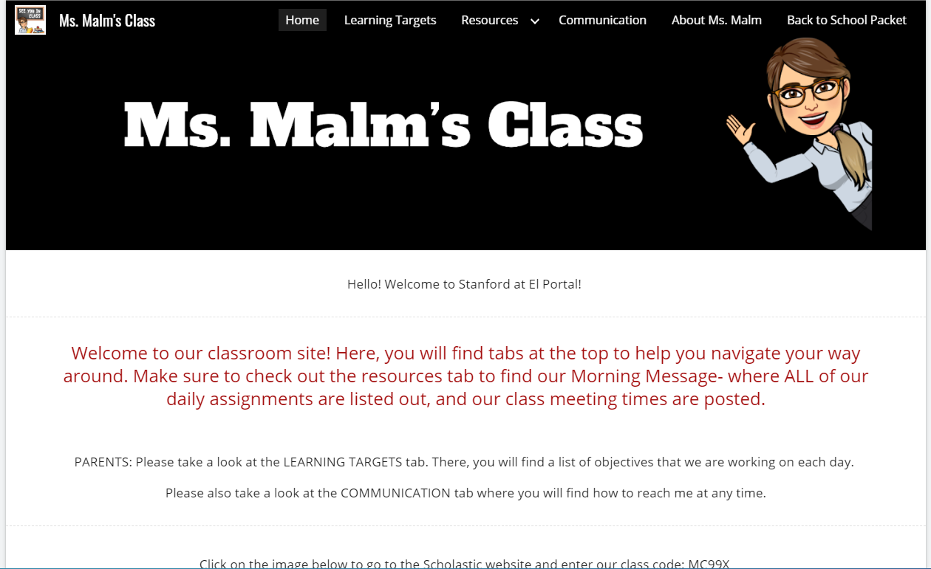

Slide 13
Frequently Asked Questions

Slide 14
Questions?
Q. How do I enroll in the Virtual Academy?
a. Complete the on-line survey to signify your intent by the April 30, 2021 deadline. A follow-up email will be sent to those families to complete their necessary enrollment forms.
Q. Is it possible that my student will be in a combo class with students from more than one grade level?
a. Yes, it is possible and highly likely depending on the number of families who enroll that students in a class may be from more than one grade and from schools other than your home school.
Q. What is the class size for the Virtual Academy?
A. The same class ratios and averages that apply to in-person teaching would apply to a virtual classroom.
Q. What is the deadline to enroll?
A. Because of the need for planning and staffing, the deadline to enroll is april 30, 2021

Slide 15
Questions continued...
Q. What kind of supports will be available for my student?
As with in-person instruction, students needing additional support will have access to small group instruction, potential time for intervention support, each teacher will have a hour of office hours each day, and other services identified through the IEP process. For students needing counseling or support from a school psychologist, those services will still be available virtually. English Language services will continue to be provided for our English learner students as well.
Q. What kind of support will be available for parents?
There will be a required training for parents of students in the Virtual Academy before the start of the year to go over log in information for access to required programs. The helpdesk@ljsd.org is also available for any tech support needs that arise with hardware such as the Chromebook and some software issues. Additional support for software will be provided by the classroom teacher or the Educational Services Department.

Slide 16
Questions continued...
Q. If I enroll in the Virtual Academy and change my mind, can I enroll in the regular program?
a. The enrollment commitment is for the 2021/2022 School year (1 year).
Q. What are the attendance requirements for my student enrolled in the Virtual Academy?
a. They are the same as if the student was attending class in person. We are required to take daily attendance and monitor student engagement as a condition of offering distance learning of any kind to our families. As such, any student not in attendance for virtual learning would be required to clear the absence following the same guidelines during in person instruction.
Q. If state and local directives require distance learning for all students, how will that compare to the Virtual Academy?
a. The EstudentdCode requirements are the same when offering distance learning for all or part of the population. So the structure for distance learning will be the same.

